Slide 1
Meeting 15
Monday 11/06/2018

Slide 2
Agenda
BEACon data
Optimization method
6 WT
Different spacing

Slide 3
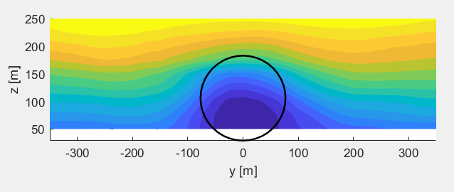
BEACon data
Why not rotor averaged wind speed?
Data from height of 50 m (lowest point of rotor is 29 m)
Non-symmetric wake (and horizontal plane at 100 m) → weighting function not possible
Plane at 100 m height: horizontal profiles

Slide 4
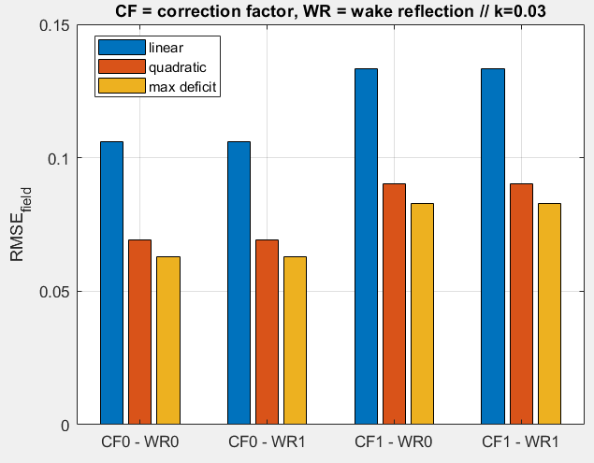
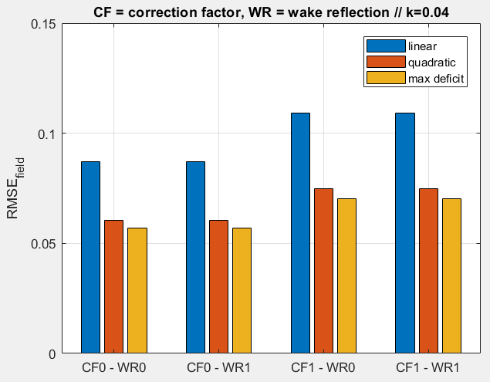
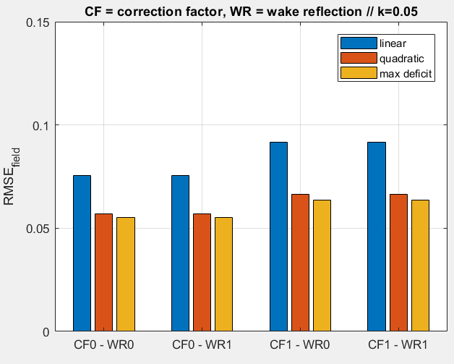
BEACon - Park
RMSE of field (0,97D upstream to 16,2D downstream, +- 1,95 cross-stream)

Slide 5
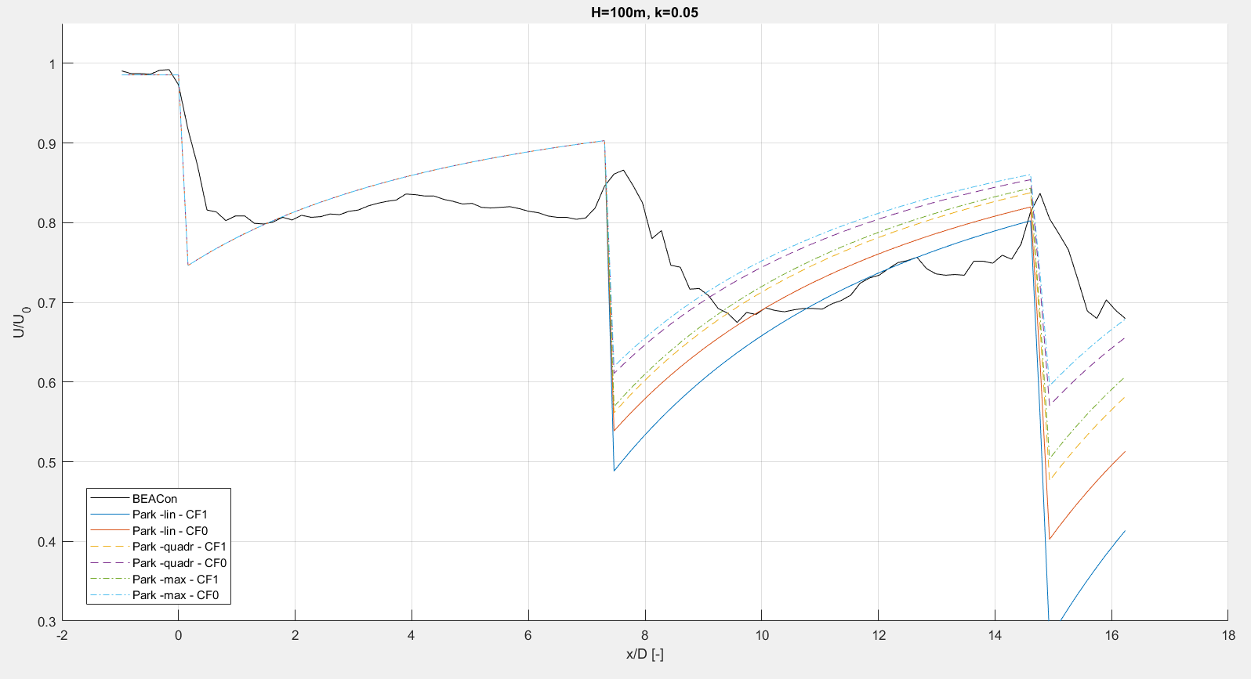
BEACon – streamwise line (Park)

Slide 6
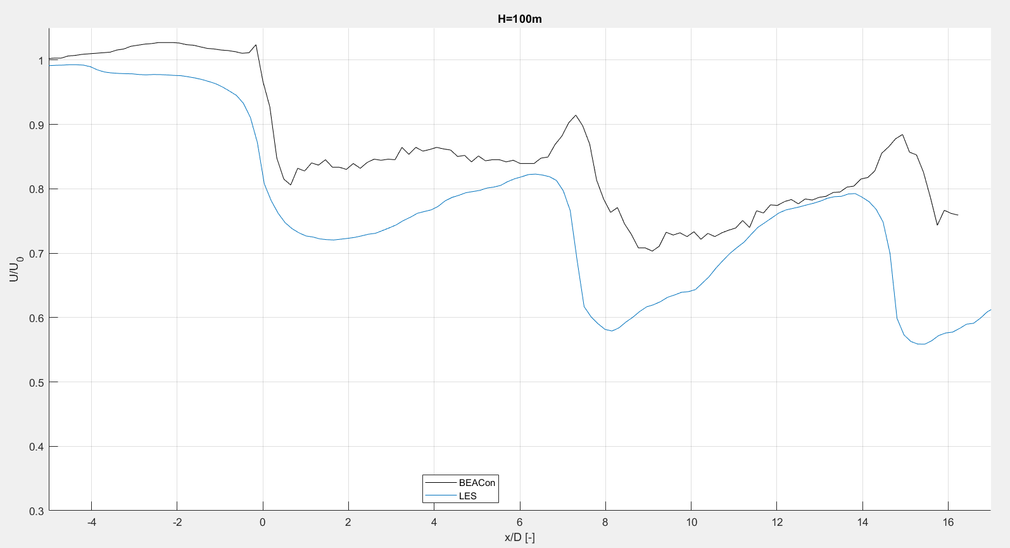
BEACon – Streamwise line (LES)

Slide 7
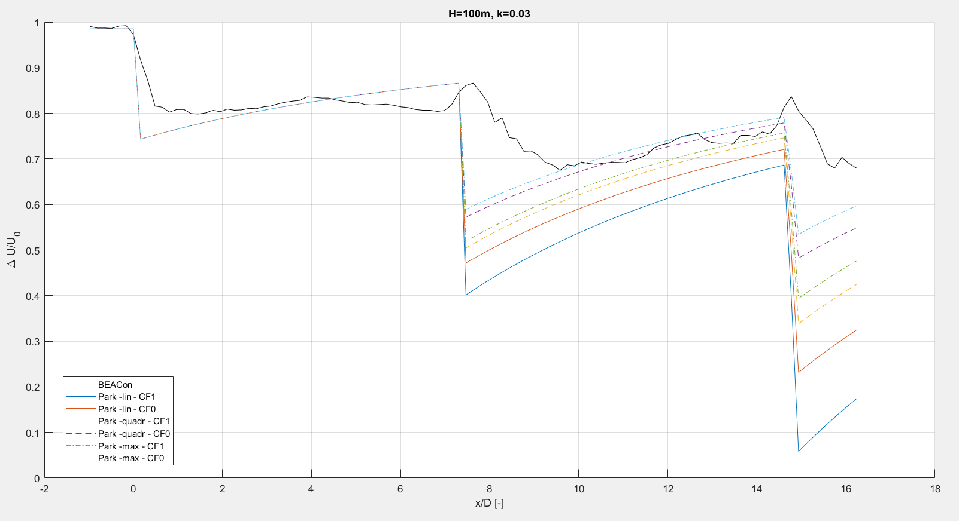
BEACon data – streamwise line

Slide 8
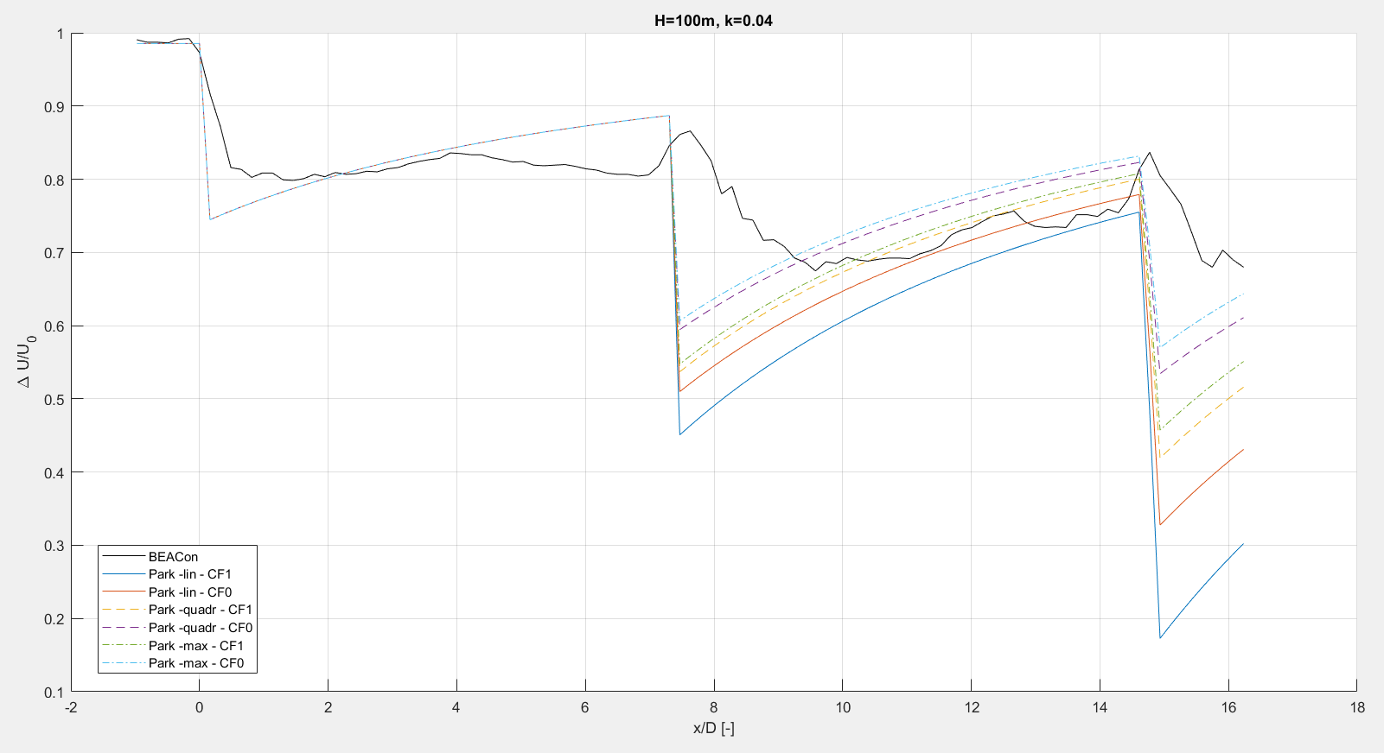
BEACon data – streamwise line

Slide 9
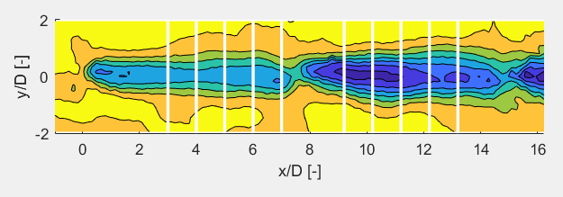
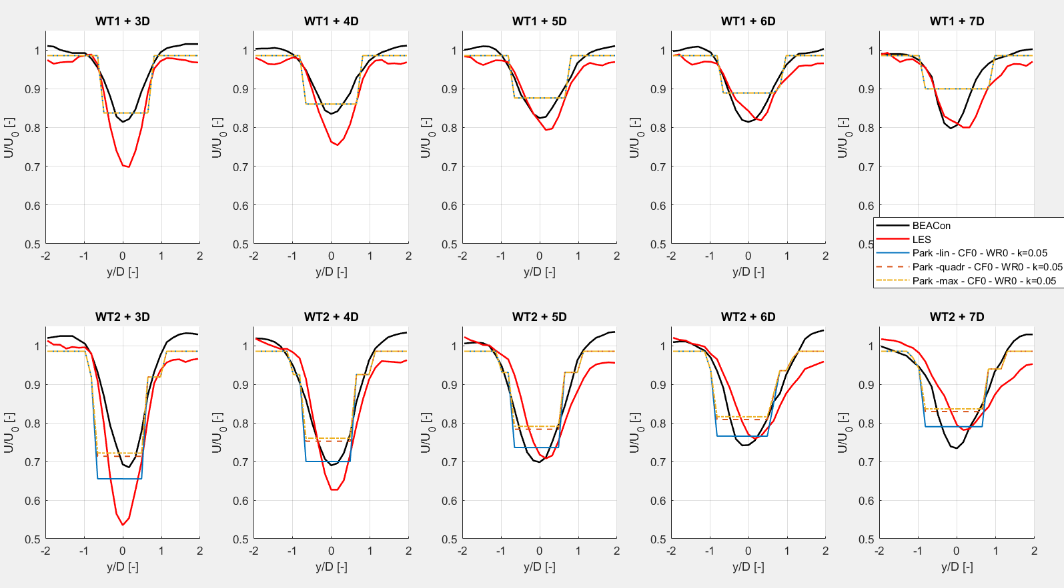
BEACon data – horizontal profiles

Slide 10
BEACon data
Instead of comparing full fields, comparing power at the turbines? (Error bar available for BEACon power data?)

Slide 11
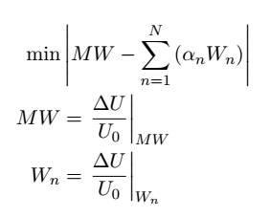
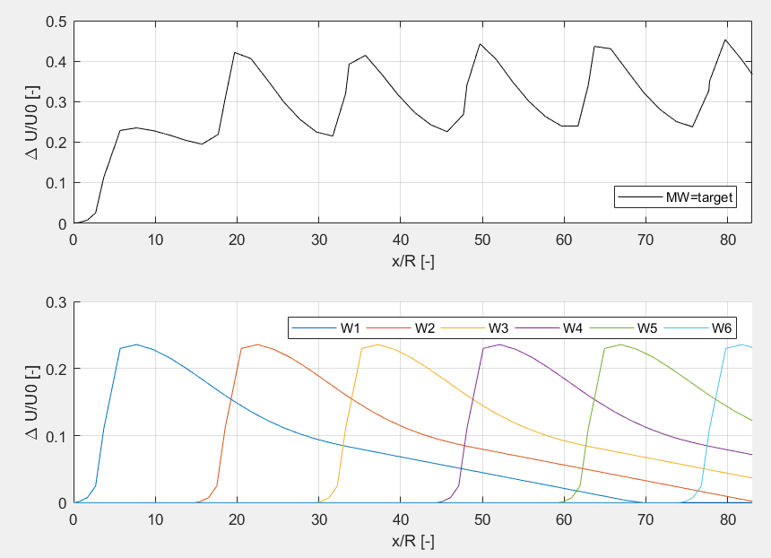
Optimization method – 6WT
Full wake 14 m/s – 6WT – TI 3,5%
Single wake 1 14 m/s – 1WT – TI 3,5%

Slide 12
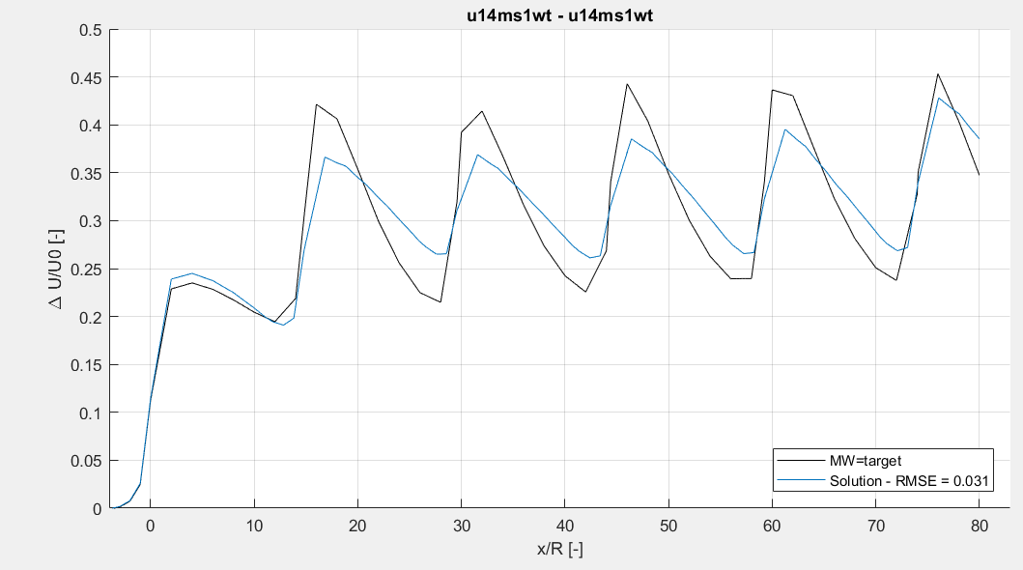
Optimization method – 6WT
Full wake 14 m/s – 6WT – TI 3,5%
Single wake 1 14 m/s – 1WT – TI 3,5%

Slide 13
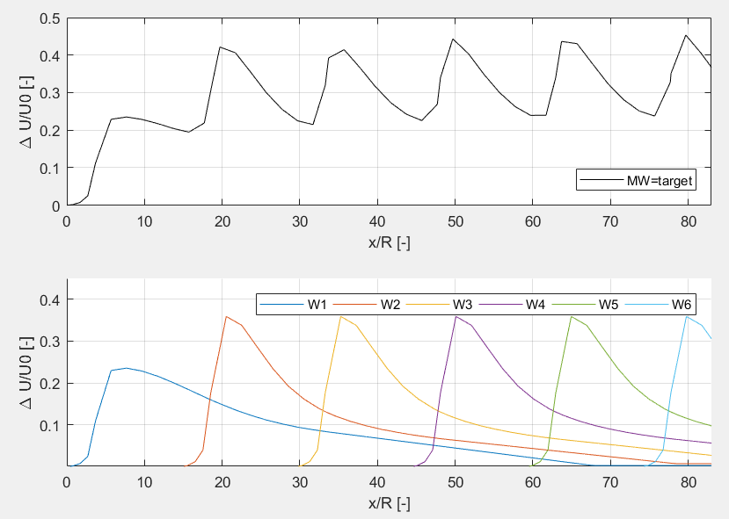
Optimization method – 6WT
Full wake 14 m/s – 6WT – TI 3,5%
Single wake 1 14 m/s – 1WT – TI 3,5% Single wake 2:N 11,2 m/s – 1 WT – TI 8%

Slide 14
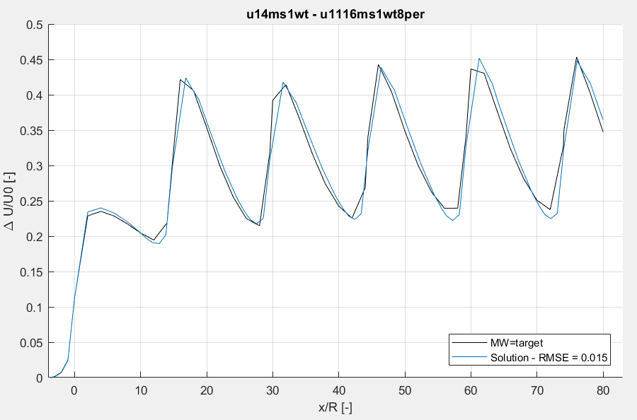
Optimization method – 6WT
Full wake 14 m/s – 6WT – TI 3,5%
Single wake 1 14 m/s – 1WT – TI 3,5% Single wake 2:N 11,2 m/s – 1 WT – TI 8%

Slide 15
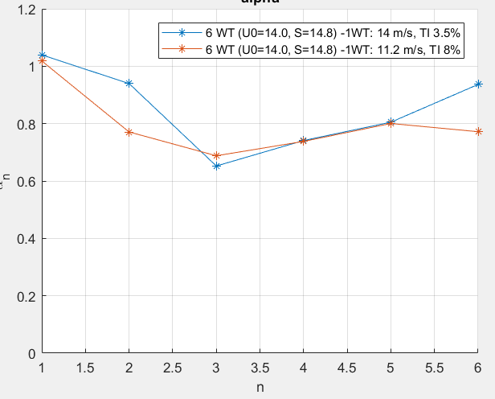

Optimization method – 6WT
Coefficients $α_{n}$
$α_{1}≅1$
$α_{2..n}<1$ Less than linear superposition

Slide 16
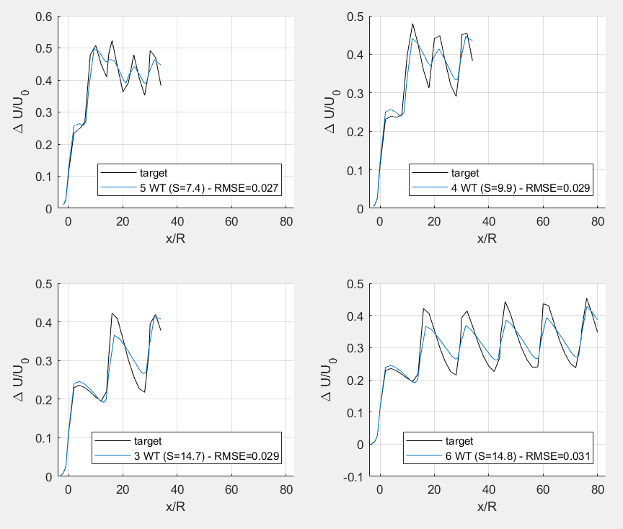
Optimization – different spacing
Full wakes 14 m/s, TI 3,5%
5 WT – S=7,4R
4 WT – S= 9,9R
3 WT – S = 14,7R
6 WT – S = 14,8R
Single wake 14 m/s – 1WT – TI 3,5%

Slide 17
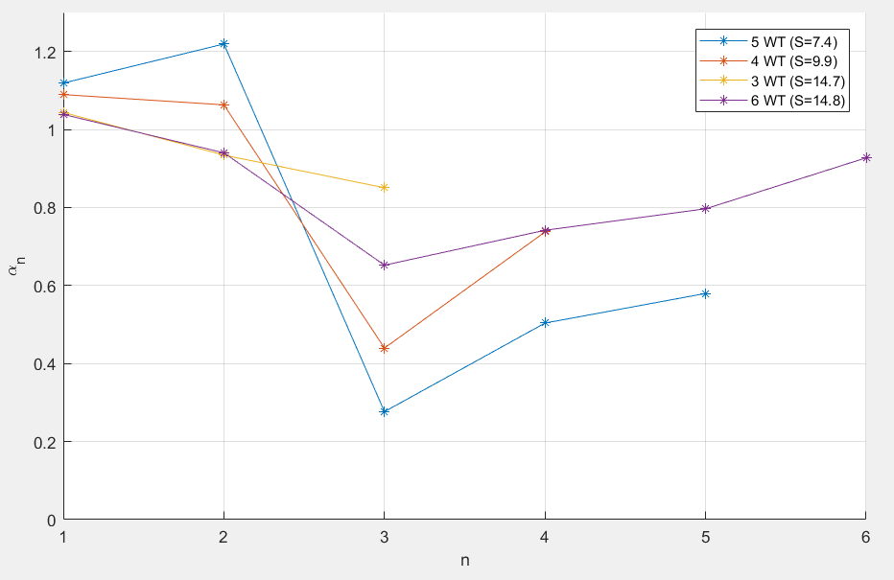

Optimization – different spacing
Do $α$ coefficients converge?
Coefficients will be different for different inflow conditions

Slide 18
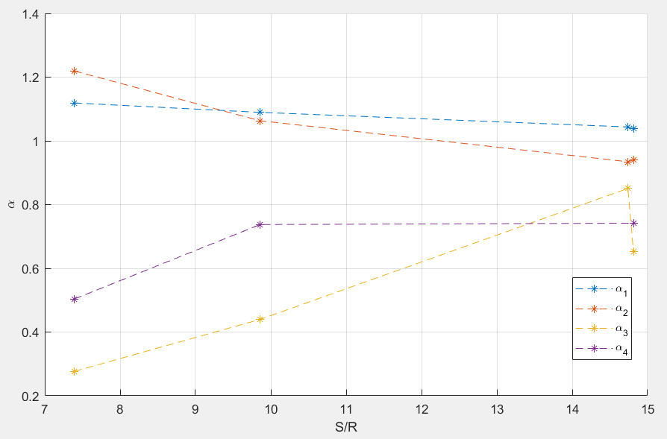

Optimization method – different spacing
Relation between $α$ coefficients and spacing?

Slide 19
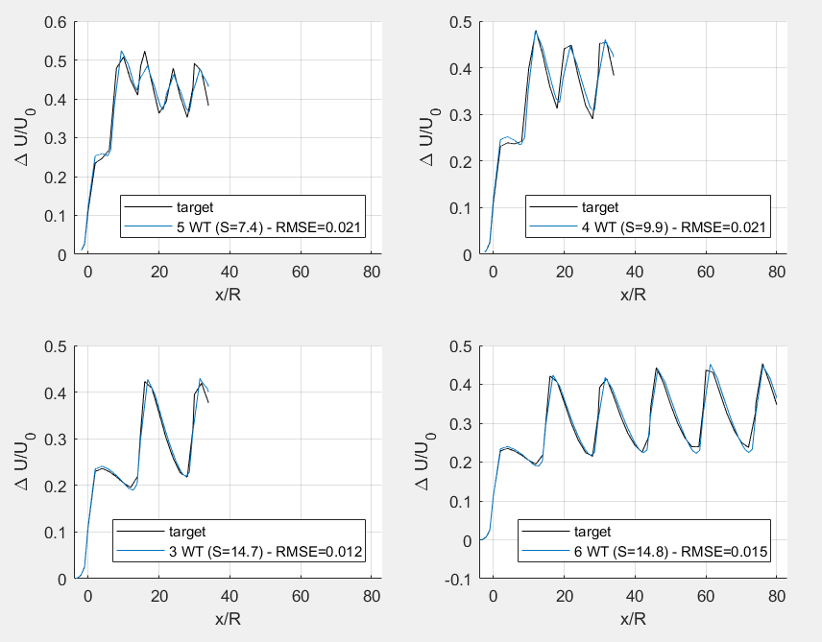
Optimization – different spacing
Full wakes 14 m/s, TI 3,5%
5 WT – dx=7,4R
4 WT – dx= 9,9R
3 WT – dx = 14,7R
6 WT – dx = 14,8R
Single wake 1 14 m/s – 1WT – TI 3,5% single wake 2:n 11,2 m/w – 1WT – TI 8%

Slide 20
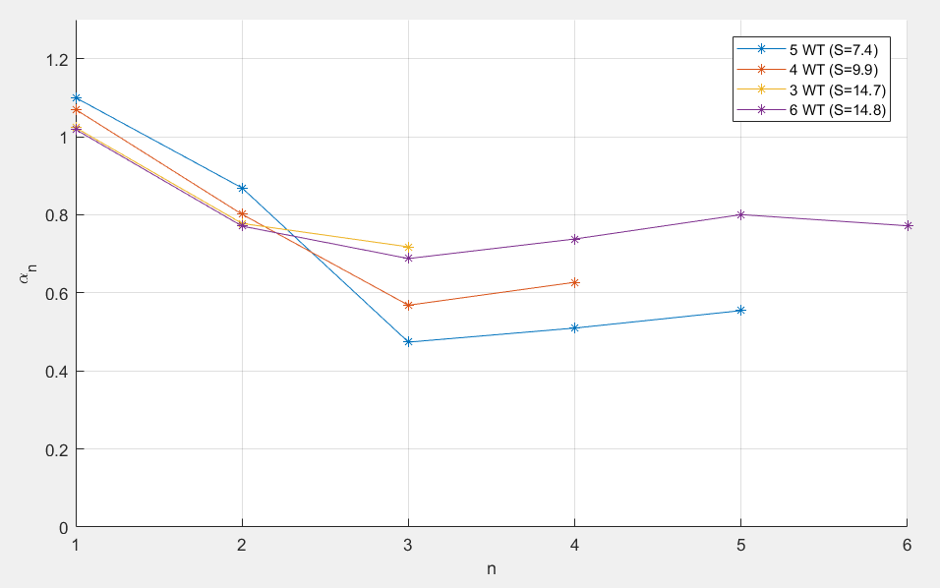

Optimization – different spacing
Do $α$ coefficients converge? (new LES simulation is running for 10 wind turbines)

Slide 21
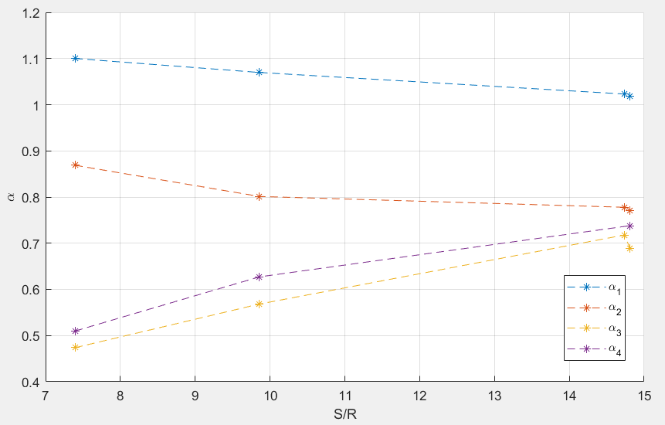

Optimization method – different spacing
Relation between $α$ coefficients and spacing?

Slide 22
Optimization method
What if single Fuga wake is used?
What is single Park wake is used?

